Slide 1
Naver Movie Review Sentiment Analysis with BERT
Deep Learning and Data Science
신철호

Slide 2
Problem Definition
contents
00
ㆍNaver movie review sentiment analysis with BERT
ㆍDetermine whether an incoming review is positive or negative

Slide 3
What is BERT?
contents
01
ㆍBERT : Bidirectional Encoder Representations from Transformers
ㆍBERT’s model architecture is based on the encoder of Transformer
ㆍBERT is pre-trained language model
Differences Between Word2Vec and BERT
ㆍWord2Vec models generate embeddings that are context-independent: ie - there is just one vector (numeric) representation for each word. Different senses of the word (if any) are combined into one single vector.
However, the BERT model generates embeddings that allow us to have multiple (more than one) vector (numeric) representations for the same word, based on the context in which the word is used. Thus, BERT embeddings are context-dependent.

Slide 4
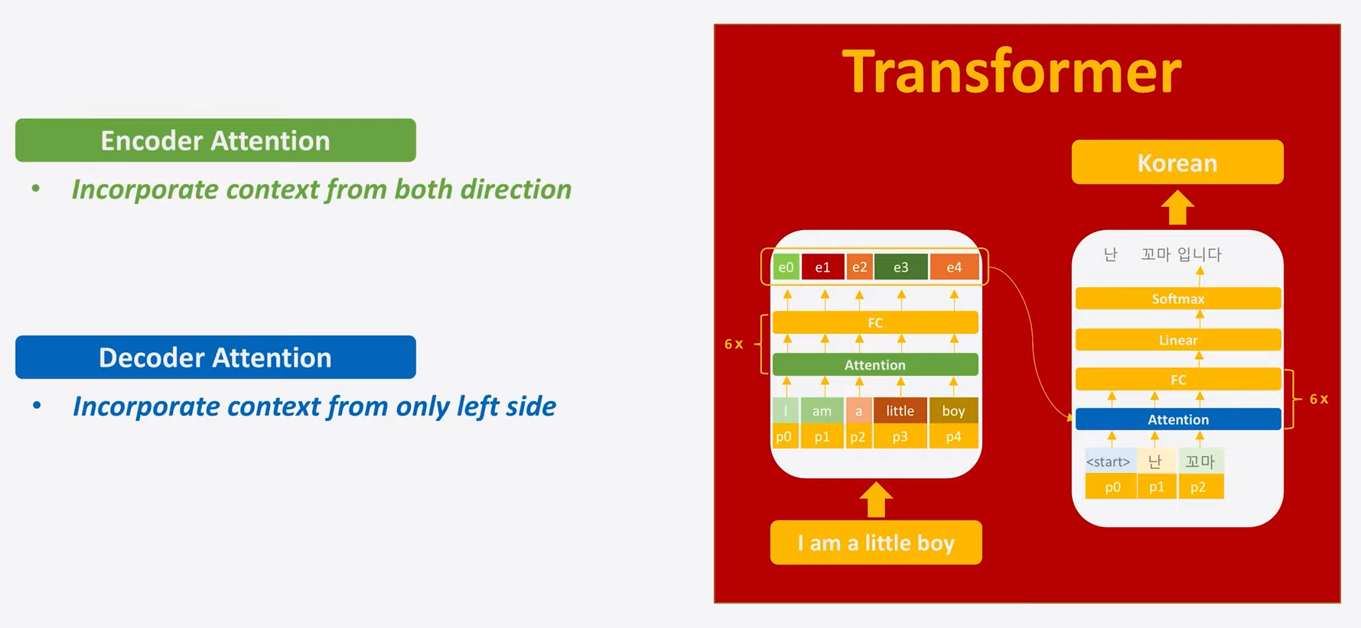
Transformer
contents
02

Slide 5

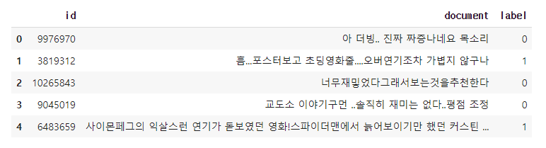
DataSet
contents
03
ㆍ150000 train data, 50000 test data
ㆍThis data consists of a total of three columns: id, document and label.
ㆍIf review is positive, label is 1. If negative, label is 0

Slide 6
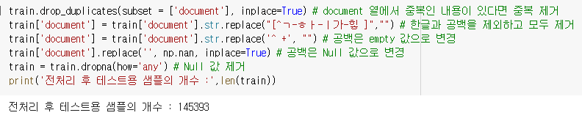
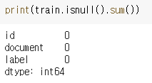
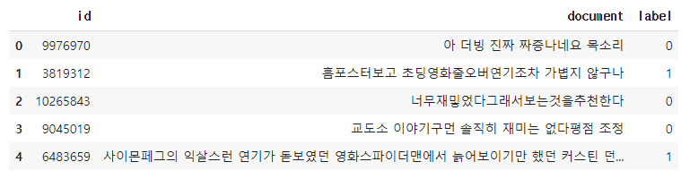
Data Preprocessing
contents
04

Slide 7
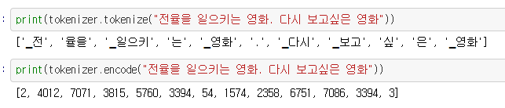
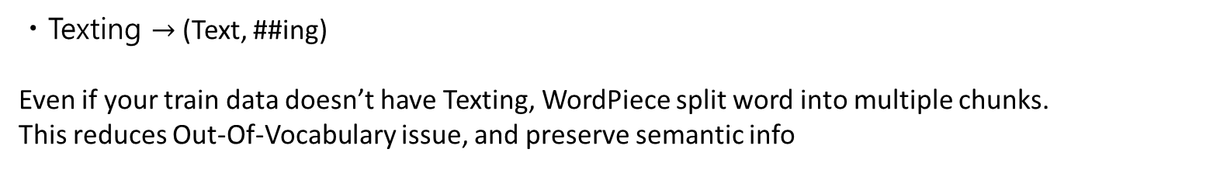
Tokenize
contents
05
ㆍWordpiece Embedding.
Word : Jet makers feud over seat width with big orders at stake
Wordpieces: _J et _makers _fe ud _over _seat _width _with _big _orders _at _stake
ㆍPlaying $→$(Play, ##ing).
ㆍTexting $→$(Text, ##ing)
Even if your train data doesn’t have Texting, WordPiece split word into multiple chunks.
This reduces Out-Of-Vocabulary issue, and preserve semantic info

Slide 8
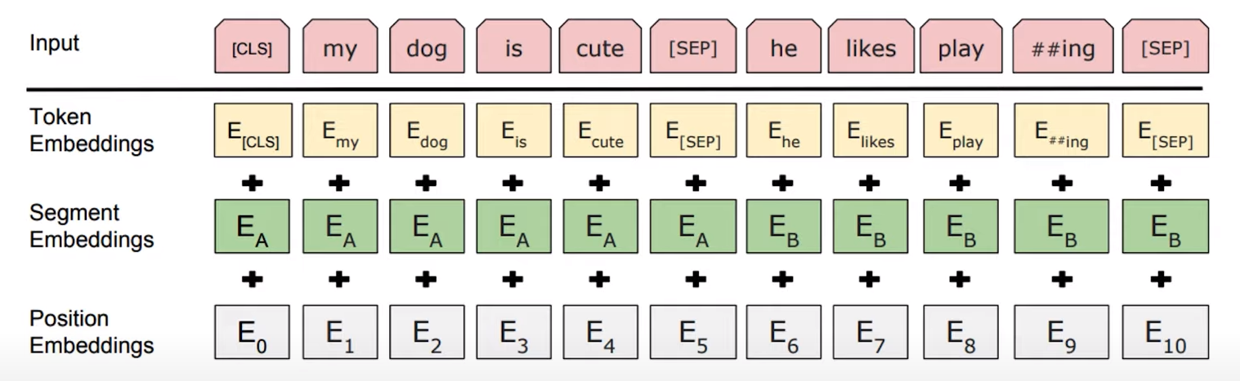
How BERT input made
contents
06
ㆍBERT's input consists of tokens, segments, and masks.
ㆍToken: Express the word based on the position value from the word dictionary.
ㆍSegment: In the BERT model, it expresses whether the sentence is former or latter
ㆍMask: whether sentence is valid value or not. If sentence is not valid, fill in with zero.

Slide 9
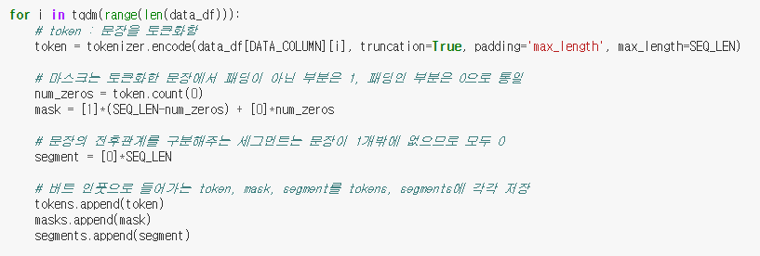
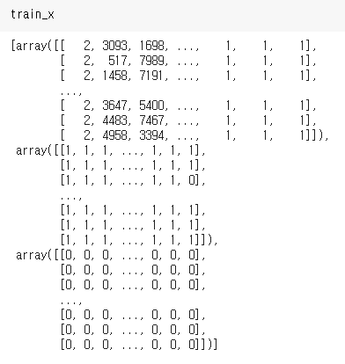

Make BERT’s Input
contents
07

Slide 10
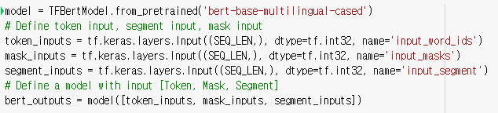
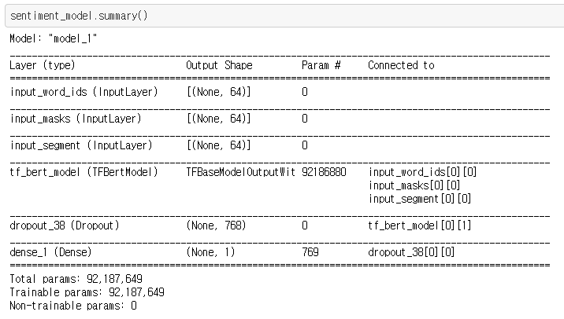
Modeling
contents
08
Parameters
ㆍSeq_len: 128
ㆍEpoch: 4
ㆍLearningrate: 0.00001

Slide 11
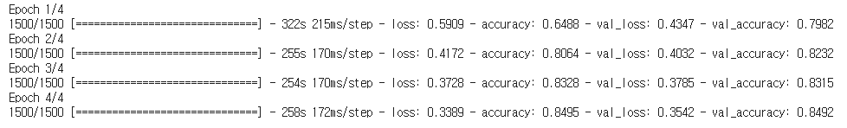
Train
contents
09

Slide 12

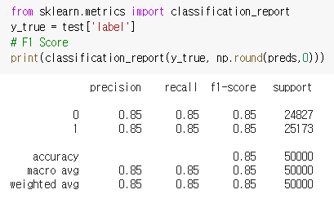
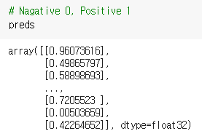
Predict(Test Set)
contents
10
Check F1-Score

Slide 13
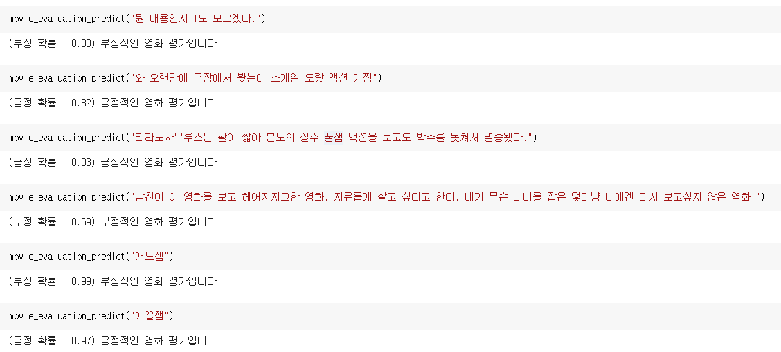

Predict(Real Data)
contents
11

Slide 14
Thank You
contents
12

